Slide 1
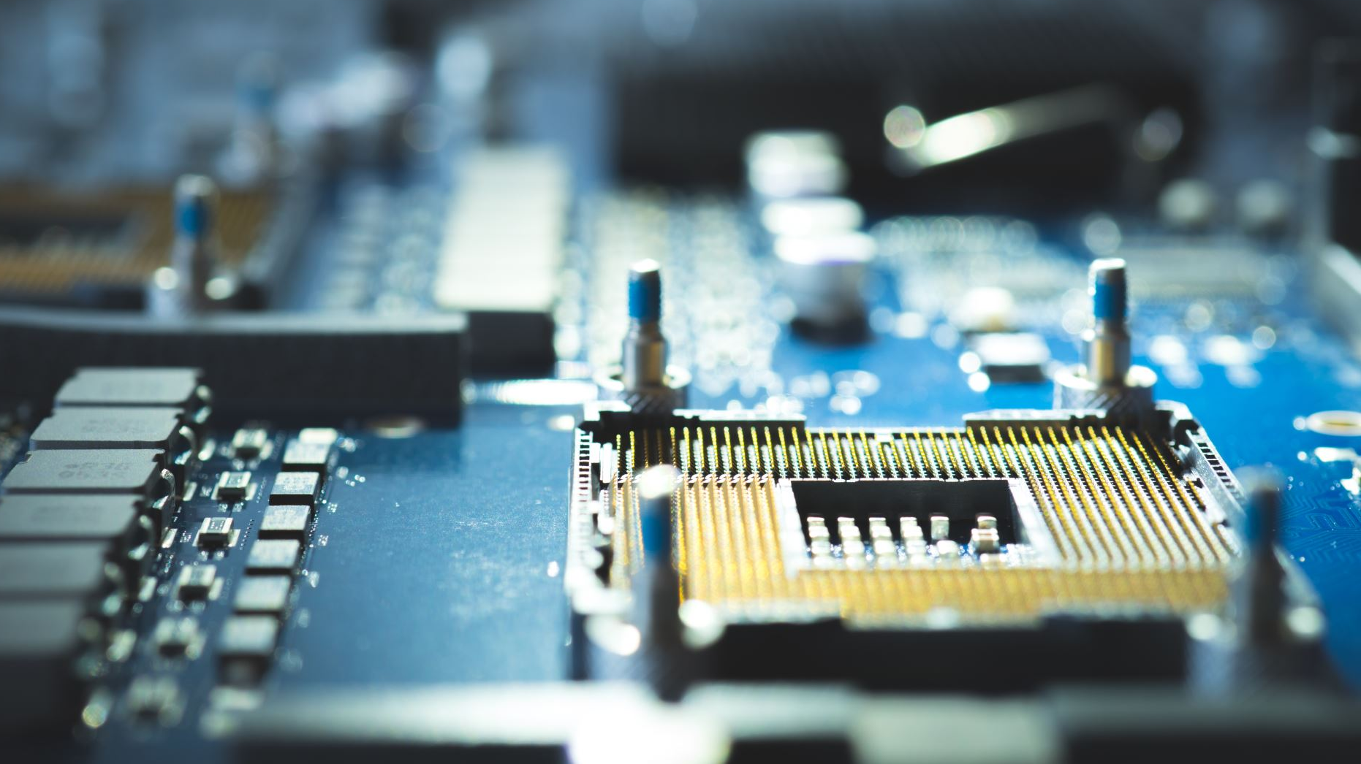
Basic Components of Computer by: Xien Genesis

Slide 2
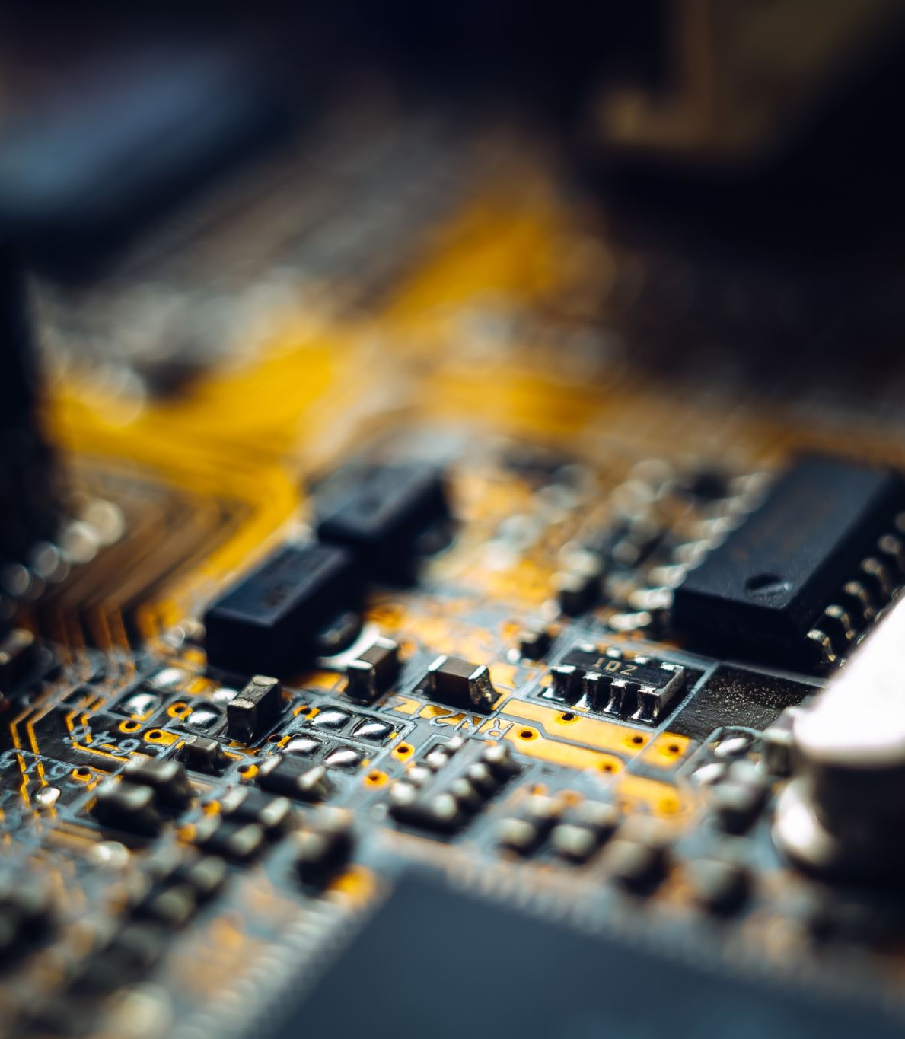
A device is made up of
Various elements which help in its
Effective functioning and processing
There are five basic components of
the computer which help in making
This processing of data easier and
Convenient

Slide 3
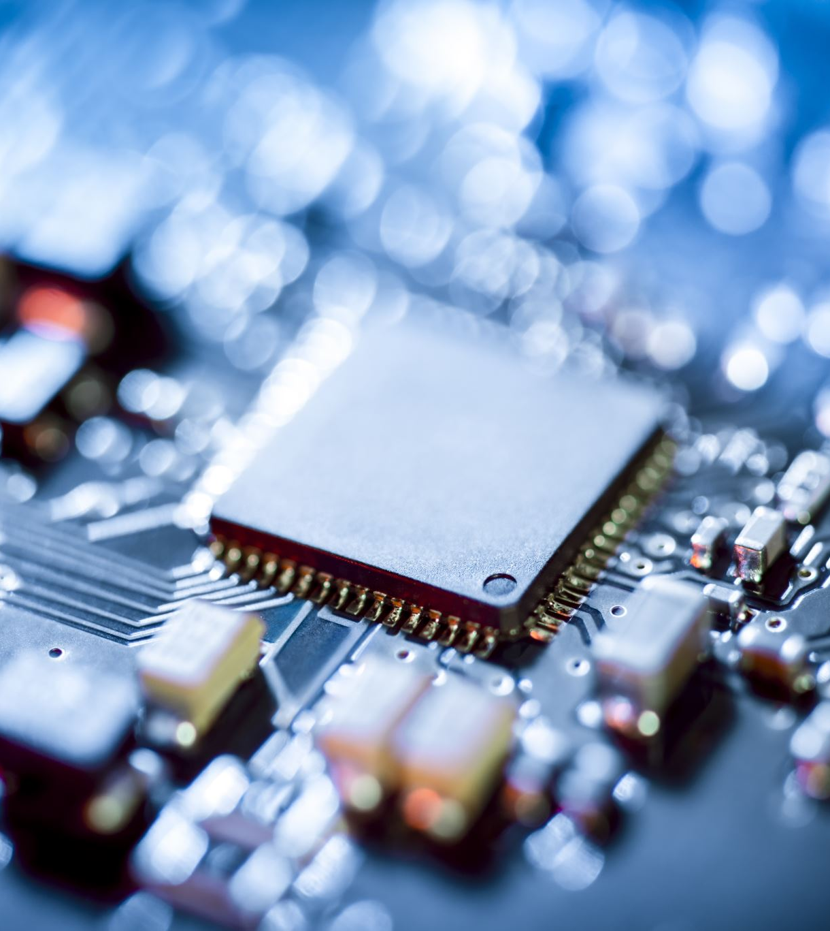
By Definition components of a computer
System are the primary elements which
Make the functioning of an electronic
Device smooth and faster. There are
Five basic components which include
Input Unit
Output Unit
Memory Unit
Control Unit
Arithmetical Unit

Slide 4
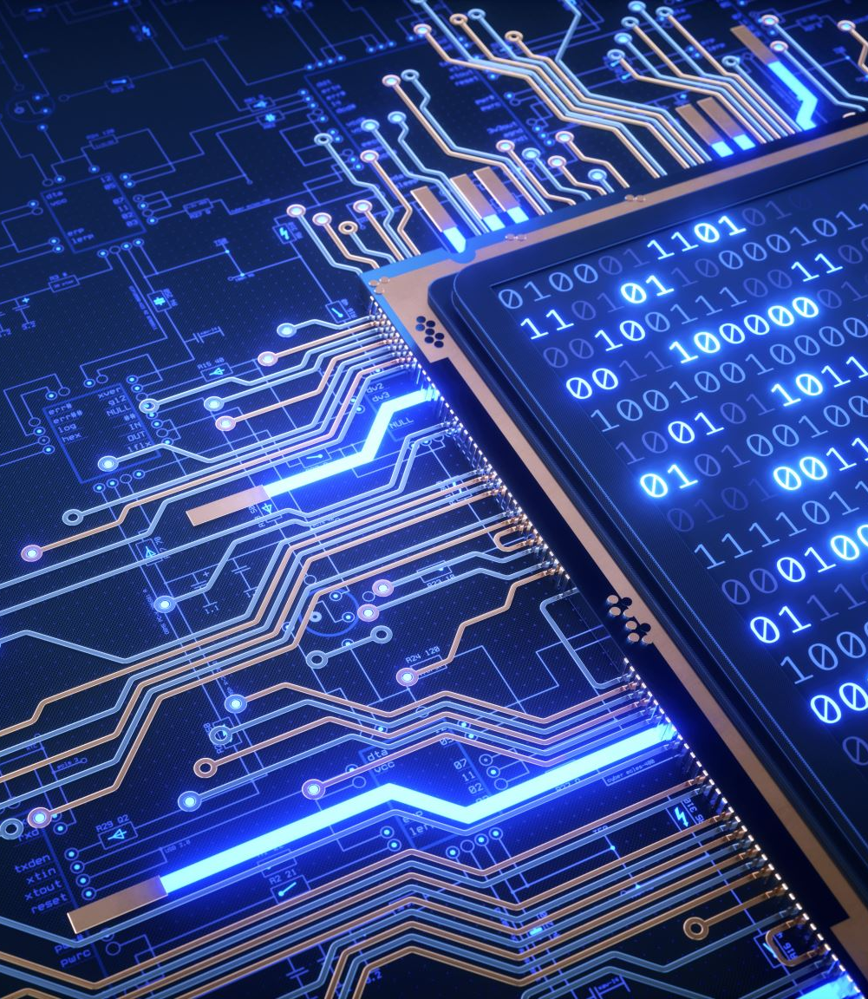
5 Components of a Computer System
Input Unit:
A computer will only respond when a
command is given to the device.
these commands can be given using
the input unit or the input
devices.

Slide 5

Output Unit
When we command a computer to
Perform a task, it reverts for
The action performed and gives us
A result. This result is called
Output. Whatever we write using keyboard
Or click using a mouse, is
All displayed on the monitor

Slide 6
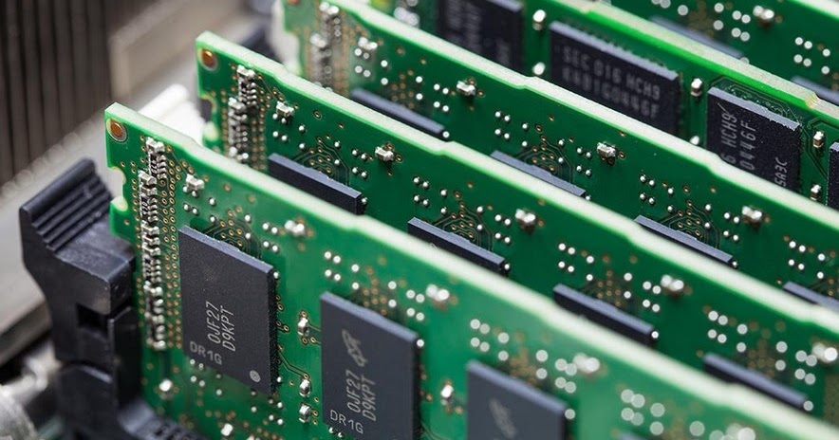
Memory Unit
When we enter the data into
The computer using an input device,
The entered information immediately gets saved
In the memory unit of the
Central Processing Unit (CPU). Because of
The presence of some existing programming,
The memory unit transmits the data
Further to the other parts of
The cpu

Slide 7

Control Unit
This is the core unit which
Manages the entire functioning of
The computer device. It is one
Of the most essential components of
The computer system
The control unit collects the data
Entered using the input unit, leads
It on for processing and once
That is done, receives the output
And presents it to the user

Slide 8
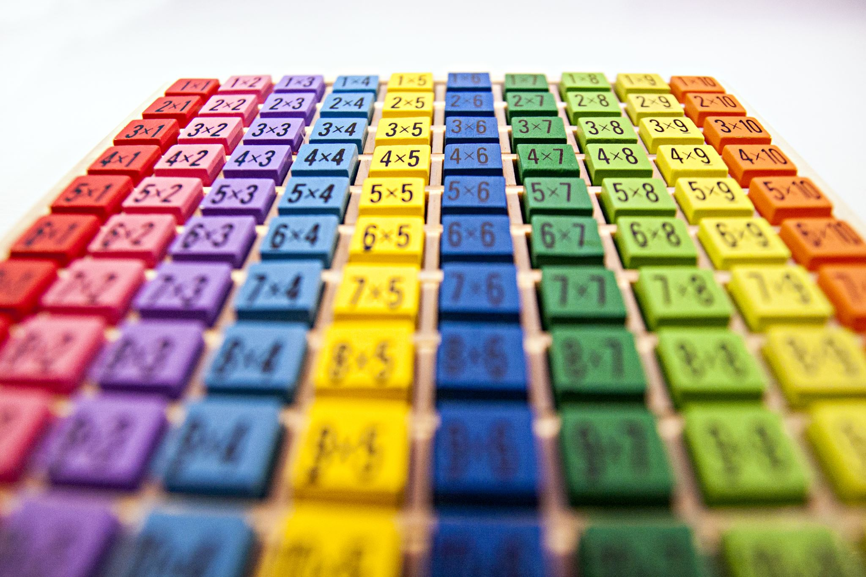
Arithmetic & Logical Unit
As the name suggests, all the
Mathematical calculations or arithmetic operations are
Performed in the arithmetic and logical
Unit of the CPU.
It can also perform actions like
A comparison of data and decision-
Making actions. The ALU comprises circuits
Using which addition, subtraction, multiplication, division
And other numerical based calculations can
Be performed

Slide 9
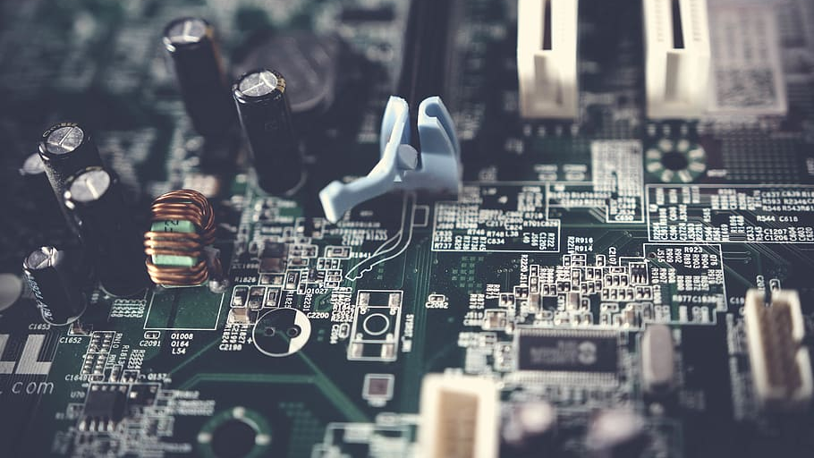
Thank you so much

